Slide 1
Binary Search Trees
44
17
88
32
65
97
28
54
82
29
7`6
80

Slide 2
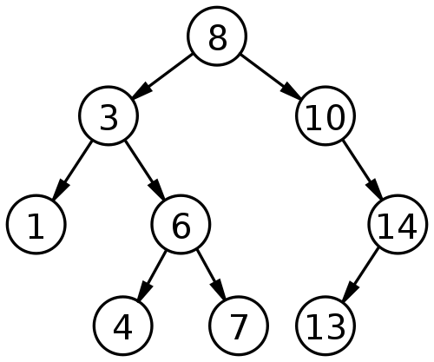
Binary Search Trees
A binary search tree (BST) is a node-based binary tree data structure which has the following properties:
The left subtree of a node contains only nodes with keys less than the node's key.
The right subtree of a node contains only nodes with keys greater than or equal to the node's key.
Both the left and right subtrees must also be binary search trees.

Slide 3
Binary Search Trees
Firstly, it is a binary tree
It is represented by a linked data structure
It combines
the advantage of an array -- the ability to do a binary search with
the advantage of a linked list -- its dynamic size
The efficiency of all of the operations is O(log n), only if the tree is reasonably height-balanced
Each node contains at least the following fields
key: an identifying field
left: pointer to a left child (may be NIL)
right: pointer to a right child (may be NIL)
p: pointer to the parent node (NIL for root)

Slide 4
Binary Search Trees
Secondly, the binary-search-tree property
For any node x,
Key [y] < Key [x] if y in left subtree of x
Key [y] ≥ Key [x] if y in right subtree of x
15
6
18
3
7
17
20
2
4
13
9

Slide 5
Binary Search Trees: Example
44
17
88
32
65
97
28
54
82
76
29
80

Slide 6
Operations on BSTs: Search
44
Search for 28
17
88
32
65
97
28
54
82
76
29
80

Slide 7
Operations on BSTs: Search
Compare with root
<
44
Search for 28
17
88
32
65
97
28
54
82
76
29
80

Slide 8
Operations on BSTs: Search
44
Search for 28
Compare with node
>
17
88
32
65
97
28
54
82
76
29
80

Slide 9
Operations on BSTs: Search
44
Search for 28
17
88
Compare with node
<
32
65
97
28
54
82
76
29
80

Slide 10
Operations on BSTs: Search
44
Search for 28
17
88
32
65
97
Compare with node
Found
28
54
82
76
29
80

Slide 11
Operations on BSTs: Search
Given a key k and a pointer to the root, Tree-Search returns a pointer to a node with key k or NIL:
Tree-Search(x, k)
if (x = = NIL or k = = key[x])
return x;
if (k < key[x])
return Tree-Search(left[x], k);
else
return Tree-Search(right[x], k);

Slide 12
Operations on BSTs: Search
Here is another function that does the same:
Tree-Search(x, k)
while (x != NIL and k != key[x])
if (k < key[x])
x = left[x];
else
x = right[x];
return x;
Which of these two functions is more efficient?

Slide 13
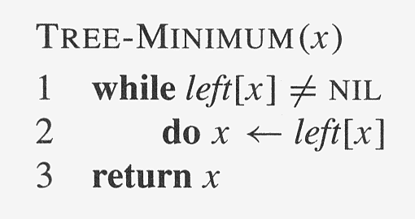
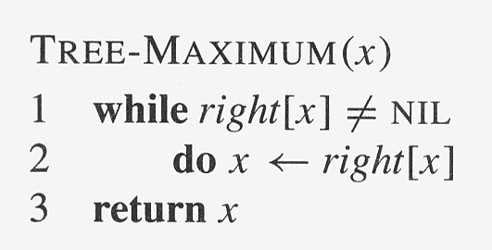
Operations on BSTs: Min & Max

Slide 14
Operations on BSTs: Successor
Two cases:
x has a right subtree: successor is minimum node in right subtree
x has no right subtree: successor is first ancestor of x whose left child is also ancestor of x
Intuition: As long as you move to the left up the tree, you’re visiting smaller nodes.
Predecessor: similar algorithm

Slide 15
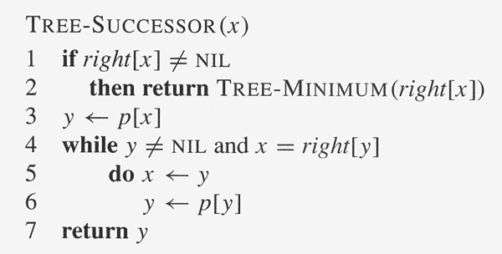
Operations on BSTs: Successor

Slide 16
Operations of BSTs: Insert
Inserts an element z to the tree so that the binary search tree property continues to hold
The basic algorithm
Like the search procedure as discussed before
Insert z in place of NIL
Use a “trailing pointer” to keep track of where you came from (like inserting into singly linked list)

Slide 17
Operations of BSTs: Insert
44
Insert 35
17
88
32
65
97
28
54
82
76
29
80

Slide 18
Operations of BSTs: Insert
Compare with root
<
44
Insert 35
17
88
32
65
97
28
54
82
76
29
80

Slide 19
Operations of BSTs: Insert
44
Insert 35
Compare with node
>
17
88
32
65
97
28
54
82
76
29
80

Slide 20
Operations of BSTs: Insert
44
Insert 35
17
88
Compare with node
>
32
65
97
28
54
82
76
29
80

Slide 21
Operations of BSTs: Insert
44
Insert 35
17
88
32
65
97
External Node
28
54
82
76
29
80

Slide 22
Operations of BSTs: Insert
44
Insert 35
17
88
32
65
97
28
35
54
82
76
29
80

Slide 23
Operations of BSTs: Insert
Example: Insert 74
44
17
88
32
65
97
28
54
82
29
76
Search for the element as if it were in the tree. When reach a NULL node, that’s where to insert.
80
NULL

Slide 24
Operations of BSTs: Insert
Example: Insert 74
44
17
88
32
65
97
28
54
82
29
76
Search for the element as if it were in the tree. When reach a NULL node, that’s where to insert.
New node
80
74

Slide 25
Function DeleteItem
First, find the item; then, delete it
Binary search tree property must be preserved!!
We need to consider three different cases:
(1) Deleting a leaf
(2) Deleting a node with only one child
(3) Deleting a node with two children
Notes:
‹#›

Slide 26
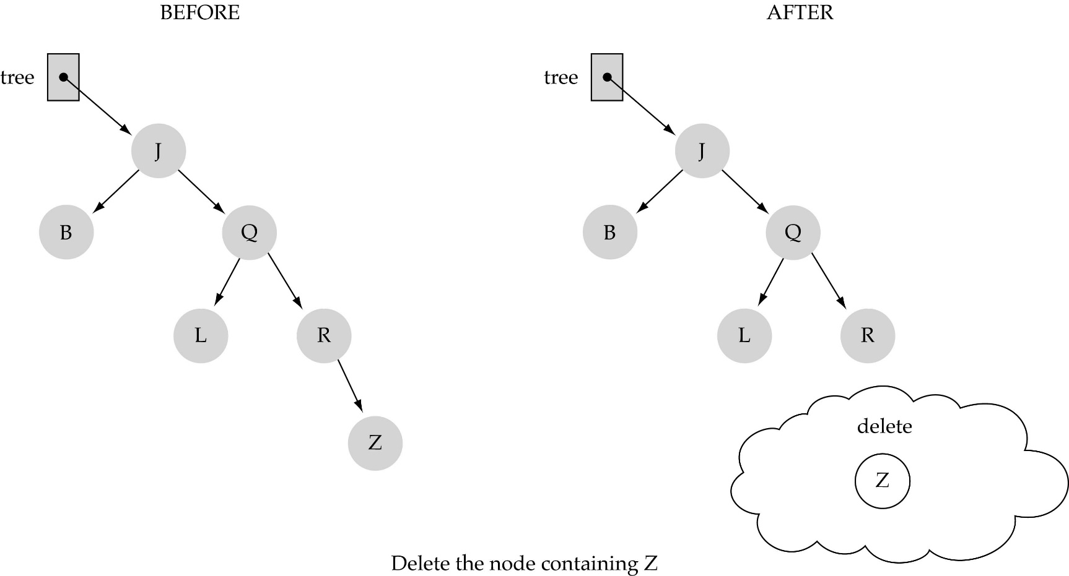
(1) Deleting a leaf
Notes:
‹#›

Slide 27
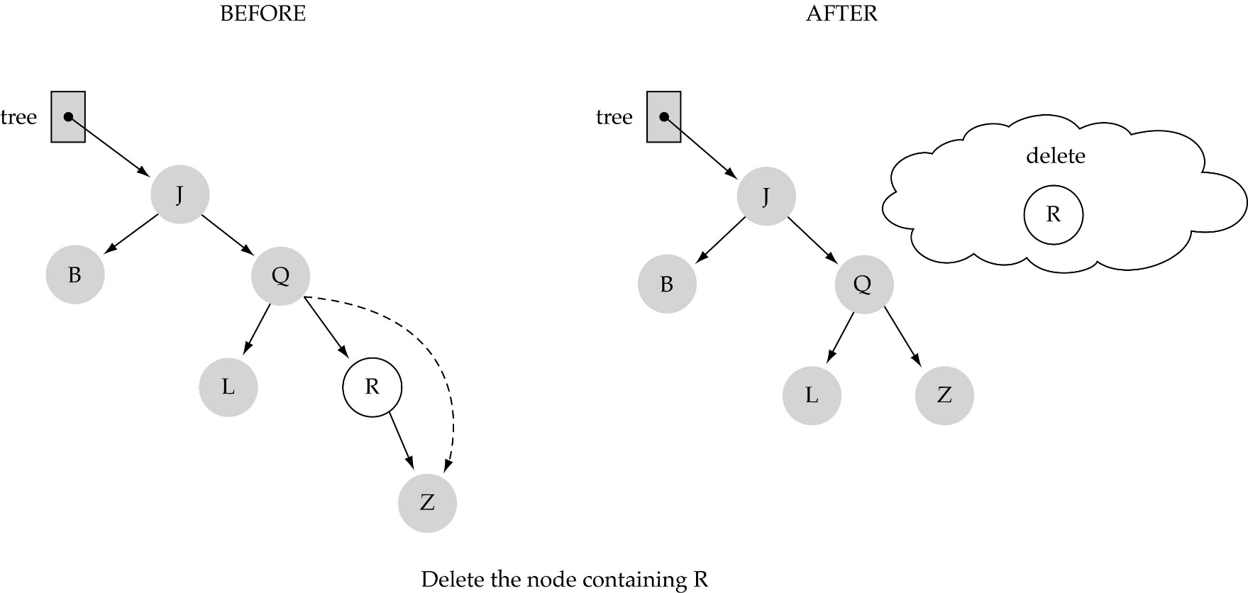
(2) Deleting a node with only one child
Notes:
‹#›

Slide 28
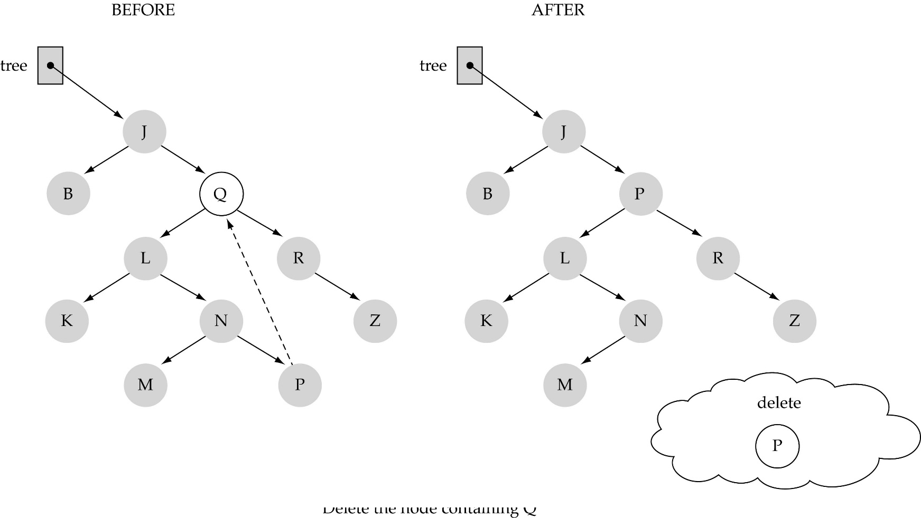
(3) Delete a node with 2 child
Notes:
‹#›

Slide 29
(3) Deleting a node with two children (cont.)
Find predecessor (i.e., rightmost node in the left subtree)
Replace the data of the node to be deleted with predecessor's data
Delete predecessor node
Notes:
‹#›

